Slide 1
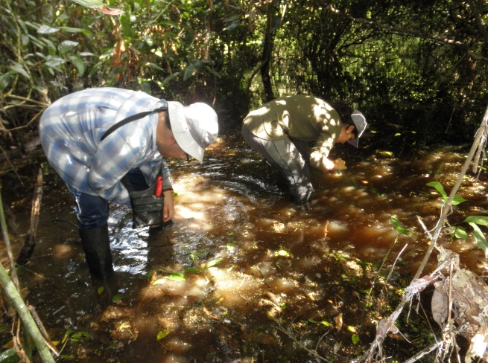
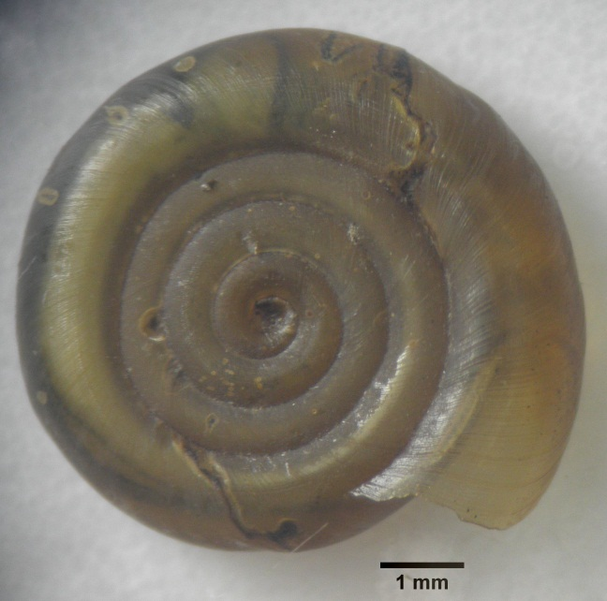
SUPPORT TO EDUCATION
AND RESEARCH
MALACOLOGY DIVERSITY RESEARCH
NATURAL HISTORY MUSEUM OF THE UNIVERSIDAD NACIONAL MAYOR DE SAN MARCOS
Students from the Biology Sciences School from the Universidad Nacional Mayor de San Marcos, have been developing a pioneer research to determine Amazonian malacological diversity. Mollusks are important indicators of the ecosystems health and are extremely unstudied species.
The research is guided by Ph.D. Rina Ramirez from Malacology department of the Natural History Museum, and a associated researcher of ITA.
The first research works began at 2008 with student Pedro Romero that conducted the research project “Pediose gland in land snails and its evolutionary implications, with emphasis on Megalobulimus” the results of this study were published at the Peruvian Biology Magazine. Vol. 17. N°1. April 2010. http://sisbib.unmsm.edu.pe/bvrevistas/biologia/v17n1/pdf/a05v17n1.pdf
On June 2011 a second research work began with students André Ampuero, Dominique Maldonado and Diego Paredes. André and Dominique belong to the Malacology Department and Diego to the Botany Department of the Natural History Museum. They have developed the research “Fresh water Malacological fauna at the low Madre de Dios river basin”. This work has been presented at the XX Biological Sciencess Research Institute Antonio Raimondi (ICBAR) of the Universidad Nacional Mayor de San Marcos.
Reference:
Ph.D. Betty Millan Salazar
Director
Natural History Museum
bmillans@unmsm.edu.pe
Ph.D. Rina Ramírez Mesíias
Chief
Malacology Department
rramirezm@unmsm.edu.pe

